Slide 1



Data Manipulation Language

Slide 2

Contents
Data Manipulation Language
INSERT INTO Statement
UPDATE Statement
DELETE Statement
SELECT Statement
Conditional SQL statements
Display Order
Grouping
Multiple Table Queries
Introduction to PL/ SQL
Introduction to T- SQL

Slide 3
Data Manipulation Language (DML)
DML describes the portion of SQL that allows you to manipulate or control your data.
Data Manipulation is:
  Insertion of new information into the database.
  Modification of information in the database.
  Deletion of information in the database.
  Retrieval of information from the database.
The goal of DML is to provide efficient human interaction with the system.
There are two types of DML:
  Procedural: the user specifies what data is needed and how to get it
  Nonprocedural: the user only specifies what data is needed
    Easier for user
    May not generate code as efficient as that produced by procedural languages

Slide 4
The Situation:
Student Particulars
    field type width contents
    id numeric 4 student id number
    name character 10 name
    dob date 8 date of birth
    gender character 1 sex: M / F
    class character 2 class
    hcode character 1 house code: R, Y, B, G
    dcode character 3 district code
    remission logical 1 fee remission
    mtest numeric 2 Math test score

Slide 5
The INSERT INTO Statement
Adds data to a table
The INSERT INTO statement is used to insert new rows into a table.
You can insert a record with all fields
You can also specify the columns for which you want to insert data:
You can also insert record from another table
INSERT INTO ...... VALUES......
INSERT INTO table_name VALUES (value1, value2,....)
INSERT INTO table_name (column1, column2,...)
VALUES (value1, value2,....)
INSERT INTO table1 SELECT * FROM table2 WHERE condition

Slide 6
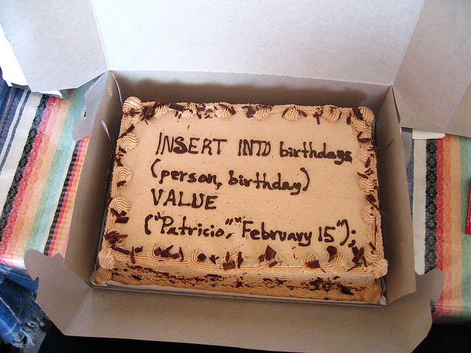
Examples

Slide 7

Examples
  INSERT INTO student VALUES (9801, ‘Peter’,’1986-04-06’ ,‘M’,’1A’,’R’,’ssp’, ‘F’,72);
  INSERT INTO student (name, gender, mtest ) VALUES (‘Manila’, ’F’, 50);
  INSERT INTO student SELECT * FROM student_backlog WHERE class=‘1B’

Slide 8

The UPDATE Statement
The UPDATE statement is used to modify the data in a table.
Once data has been inserted into a table in the database, we can access individual attributes to update them
The data may require updating either because of some change in the data value we now need to store, or as the result of some mistake having been discovered, such as the misspelling of a person's name.
UPDATE table_name
SET column_name = new_value
WHERE column_name = some_value

Slide 9

Examples
Consider a situation where we wish to update the maths test score , such as changing the mtest field to 25 of student ‘Peter’
        UPDATE student set mtest=75
        WHERE name=‘Peter’
Update several columns in a row
        UPDATE student set mtest=25,remission=‘T’
        WHERE name=‘Peter’

Slide 10

The DELETE Statement
The DELETE statement is used to delete rows in a table.
The DELETE FROM operation can be performed on individual or multiple rows of data in a table.
The WHERE clause can be used to identify which rows are to be removed.
Note, however, this does not remove the actual table from the database - only the data content of the table.
DELETE FROM table_name
WHERE column_name = some_value

Slide 11

Examples
For example, the SQL statement shown below deletes the row in the students table where the name attribute matches the value ‘Jenny’.
    DELETE FROM student
    WHERE name=‘Jenny’

Slide 12
The SELECT Statement
General structure of “select” clause
SELECT ...... FROM ...... WHERE ......
SELECT [ALL / DISTINCT] expr1 [AS col1], expr2 [AS col2] ;
FROM tablename WHERE condition

Slide 13
SELECT…
SELECT [ALL / DISTINCT] expr1 [AS col1], expr2 [AS col2] ;
FROM tablename WHERE condition
  The query will select rows from the source tablename and output the result in table form.
  Expressions expr1, expr2 can be :
    a column, or
    an expression of functions and fields.
  And col1, col2 are their corresponding column names in the output table.
  DISTINCT will eliminate duplication in the output while ALL will keep all duplicated rows.
  condition can be :
    an inequality, or
    a string comparison(using logical operators AND, OR, NOT.)

Slide 14
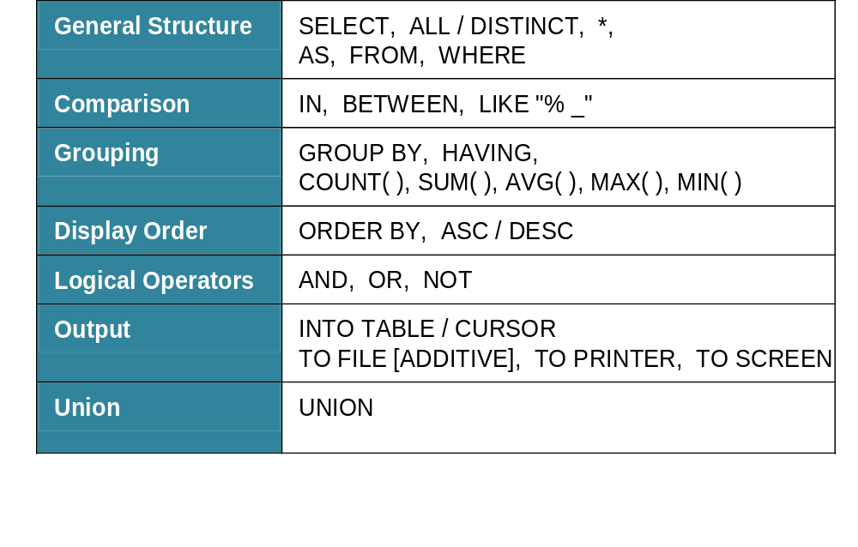
Basic structure of an SQL SELECT query

Slide 15
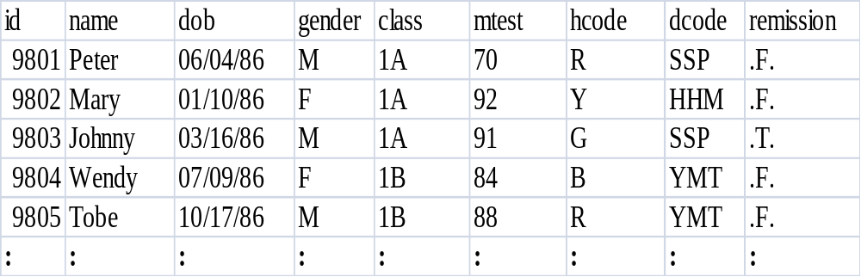
Simple select statements
  Eg. List all the student records.
  SELECT * FROM student
Result

Slide 16
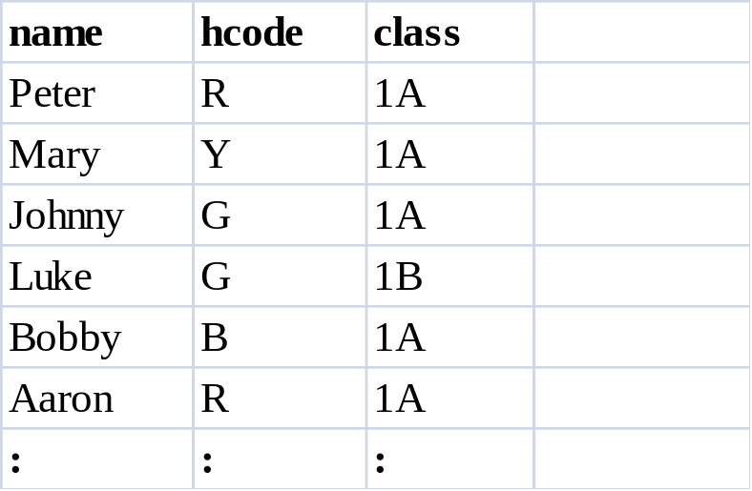
Simple select statements
It may be that we are only interested in a particular number of attributes in the relation. Consider the effect of the SQL statement illustrated below:
    eg: SELECT name, hcode, class FROM student
Result

Slide 17
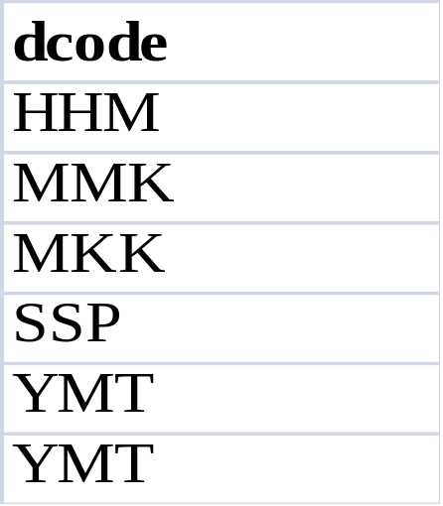
Simple select statements
Unlike the relational model, SQL does not automatically remove duplicates of records returned by the execution of a query. Consider the effect of the SQL statement illustrated below:
  eg. List the residential district of the students
  SELECT dcode FROM student ;
Result

Slide 18
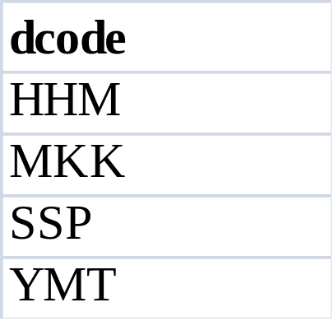
Simple select statement using DISTINCT
If this is not what we want, then we can limit the query to remove such duplicates.
This can be achieved by the use of the keyword UNIQUE or DISTINCT being added after the SELECT keyword. This is illustrated in the following SQL statement:
  SELECT DISTINCT dcode FROM student ;
Result

Slide 19
Conditional SQL statements
We can put conditions on the SQL statement such that only records with particular attribute values will be returned from the database.
To conditionally select data from a table, a WHERE clause can be added to the SELECT statement.
  eg. List the names and house code of 1A students.
  SELECT name, hcode, class FROM student ;
WHERE class="1A"
Class
Class
1A
✓
1A
1A
✓
1A
class="1A"
✓
1A
1A
1B
✗
1B
1B
✗
1B
:
:

Slide 20
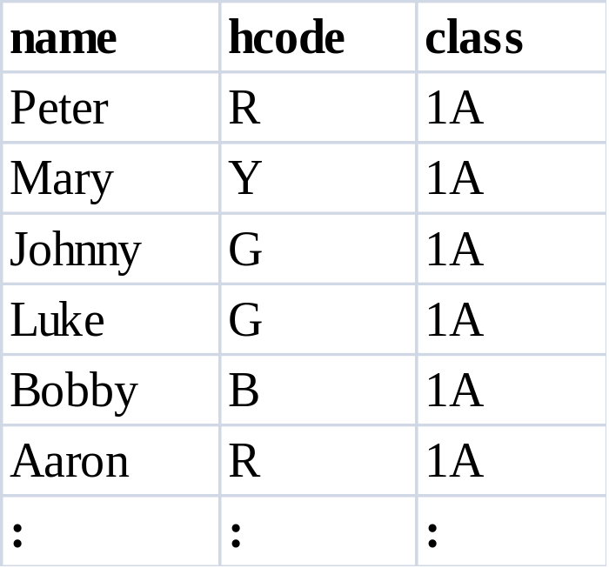
Conditional SQL statements
  Eg. List the names and house code of 1A students.
Result

Slide 21
Conditional SQL statements
The WHERE clause can include multiple conditions.
Operator | Description
= | Equal
<> | Not equal
> | Greater than
< | Less than
>= | Greater than or equal
<= | Less than or equal
AND | Logical And
OR | Logical Or
NOT | Logical NOT
Comparison
Operators
Logical
Operators
Note: In some versions of SQL the <> operator may be written as !=

Slide 22


Conditional SQL statements(Example)
  eg. List the names and ages (1 decimal point) of 1B girls.
1B Girls ?
  Condition for "1B Girls":
    1) class = "1B"
    2) gender = "F"
    3) Both ( AND operator)

Slide 23
Conditional SQL statements(Example)
What is "age"?
Functions:
# days :DATE( ) – dob
# years :(DATE( ) – dob)
1 d.p.: ROUND(__ , 1)

Slide 24
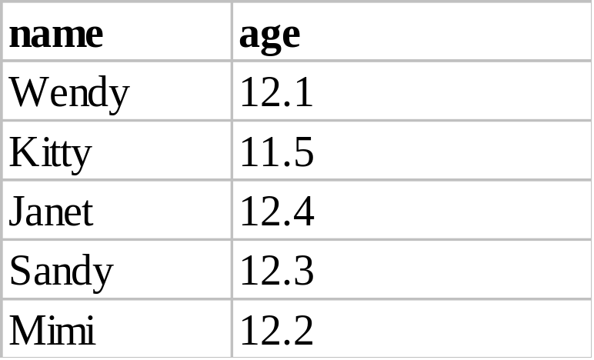
Conditional SQL statements(Example)
  SELECT name, ROUND((DATE( )-dob)) AS age ;
  FROM student WHERE class="1B" AND sex="F"
Result

Slide 25
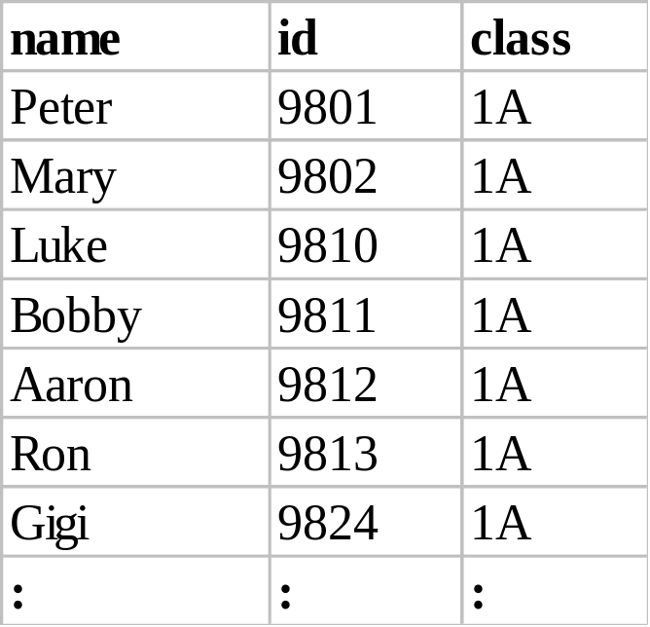
Conditional SQL statements(Example)
  Eg. List the names, id of 1A students with no fee remission.
  SELECT name, id, class FROM student ;
WHERE class="1A" AND NOT remission
Result

Slide 26
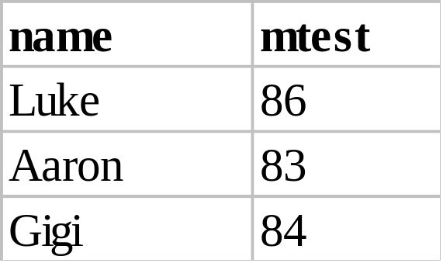
Conditional SQL statements(Example)
  eg. List the 1A students whose Maths test score is between 80 and 90 (incl.)
  SELECT name, mtest FROM student ;
WHERE class="1A" AND ;
mtest BETWEEN 80 AND 90
Result

Slide 27
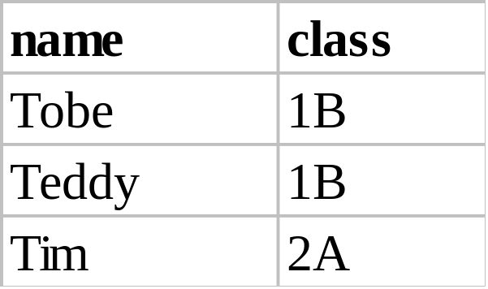
Conditional SQL statements(Example)
  eg. 9 List the students whose names start with "T".
  SELECT name, class FROM student ;
WHERE name LIKE "T%"
Result

Slide 28
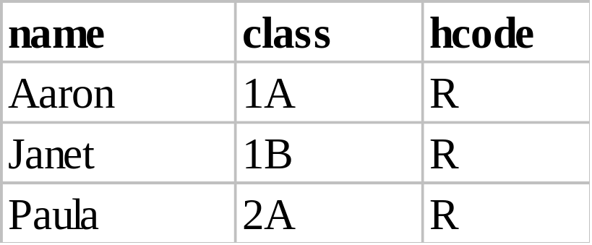
Conditional SQL statements- Set Membership(Example)
  Eg. List the Red house members whose names contain "a" as the 2nd letter.
  SELECT name, class, hcode FROM student ;
WHERE name LIKE "_a%" AND hcode="R"
Result

Slide 29
Conditional SQL statements -Set Membership
The WHERE clause can be further modified to test if an attribute has a value which is member of a particular set. This is achieved using the IN condition.
expr IN ( value1, value2, value3)

Slide 30
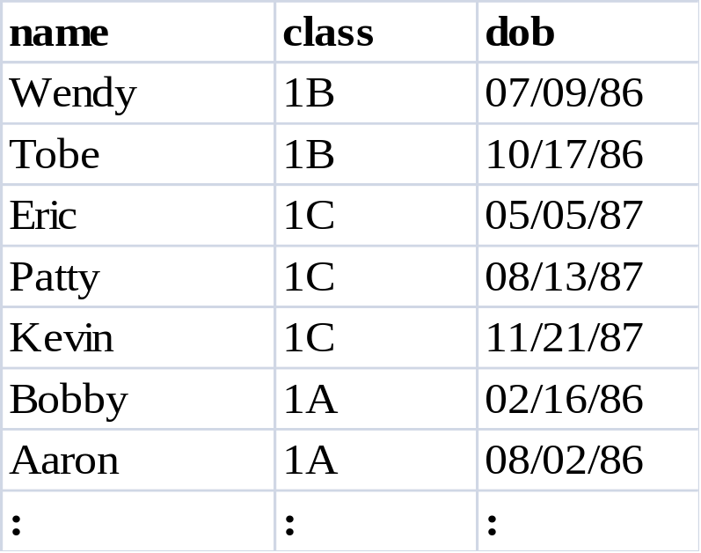
Conditional SQL statements- Set Membership(Example)
  Eg. List the students who were born in July, October, May, August, November.
  SELECT name, class, dob FROM student ;
WHERE MONTH(dob) IN (7,10,5,8,11,2)
Result

Slide 31
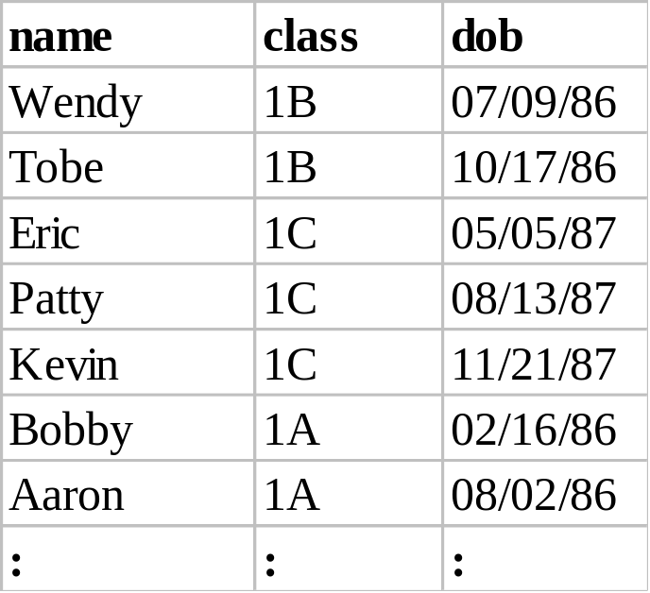
Conditional SQL statements- Set Membership(Example)
  Eg. List the students who were not born in January, March, June, September.
  SELECT name, class, dob FROM student ;
WHERE MONTH(dob) NOT IN (1,3,6,9)
Result

Slide 32

Display Order
Most database systems will have a default ordering of the results of queries.
Such order can be overridden by using the ORDER BY clause in SQL.
The ordering can be made ascending or descending by the use of ASC or DESC keywords. Ordering can also be achieved on multiple attributes.
SELECT ...... FROM ...... WHERE ......
ORDER BY column_name ASC / DESC

Slide 33
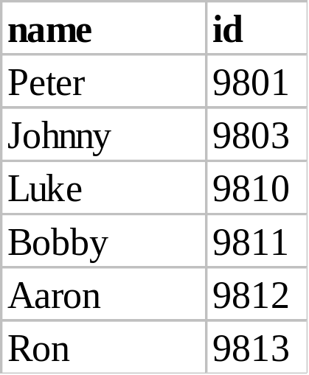
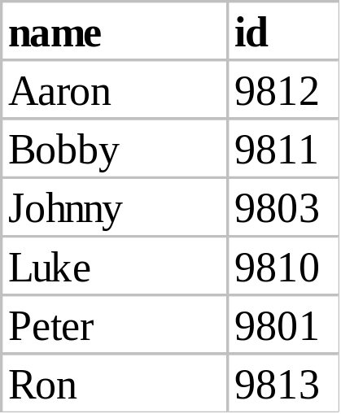
Display Order(Example)
  Eg. List the boys of class 1A, order by their names.
  SELECT name, id FROM student ;
WHERE sex="M" AND class="1A" ORDER BY name
Result
ORDER BY
name

Slide 34
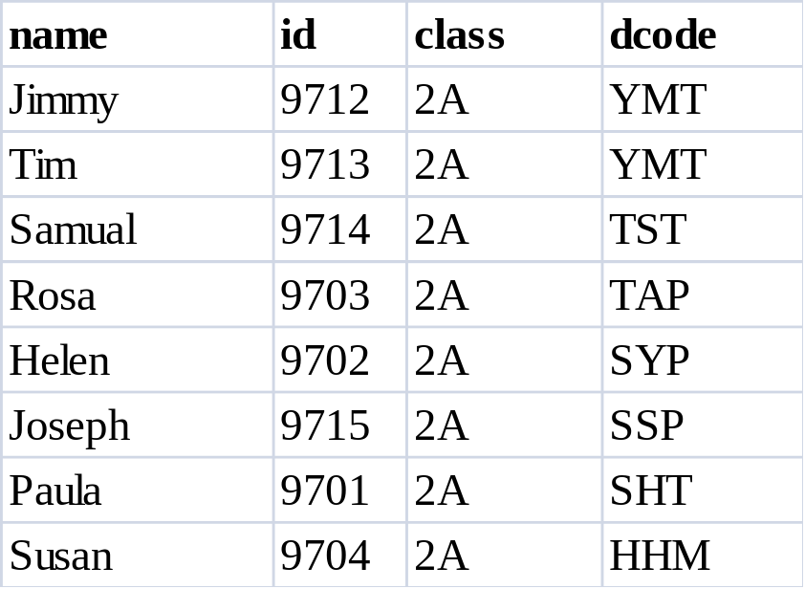
Display Order(Example)
  Eg. List the 2A students by their residential district.
  SELECT name, id, class, dcode FROM student ;
WHERE class="2A" ORDER BY dcode DESC
Result

Slide 35
Grouping
The GROUP BY statement is used in conjunction with the aggregate functions to group the result-set by one or more columns.
SELECT ...... FROM ...... WHERE condition ;
GROUP BY groupexpr [HAVING requirement]
Group functions:
COUNT( ), SUM( ), AVG( ), MAX( ), MIN( )
  groupexpr specifies the related rows to be grouped as one entry. Usually it is a column.
  WHERE condition specifies the condition of individual rows before the rows are group. HAVING requirement specifies the condition involving the whole group.

Slide 36

Grouping(Example)
  Eg. List the number of students of each class.

Slide 37
Group By Class
class
1A
1A
1A
1A
COUNT( )
1A
1B
1B
1B
1B
1B
COUNT( )
1B
1B
1B
1C
1C
1C
COUNT( )
1C
1C
Student

Slide 38
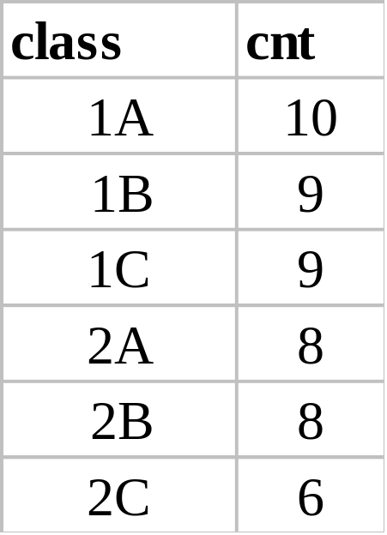
Grouping(Example)
  Eg. List the number of students of each class.
  SELECT class, COUNT(*) FROM student ;
GROUP BY class
Result

Slide 39

Grouping(Example)
  eg. List the average Math test score of each class.

Slide 40
Group By Class
class
1A
1A
AVG( )
1A
1A
1B
1B
1B
1B
AVG( )
1B
1B
1B
1C
1C
AVG( )
1C
1C
Student

Slide 41
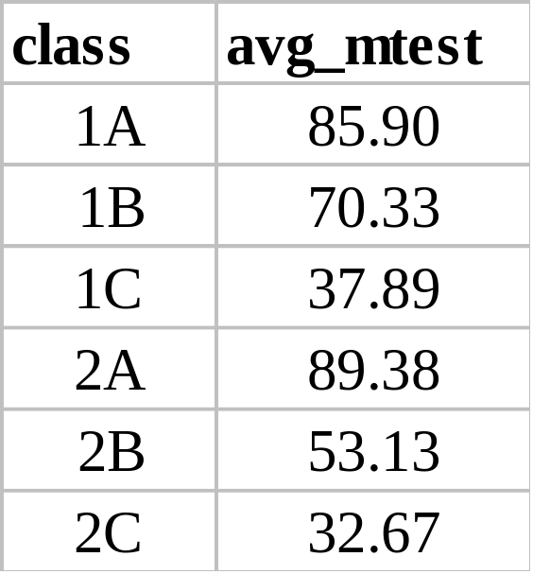
Grouping(Example)
  eg. List the average Math test score of each class.
  SELECT class, AVG(mtest) FROM student ; GROUP BY class
Result

Slide 42
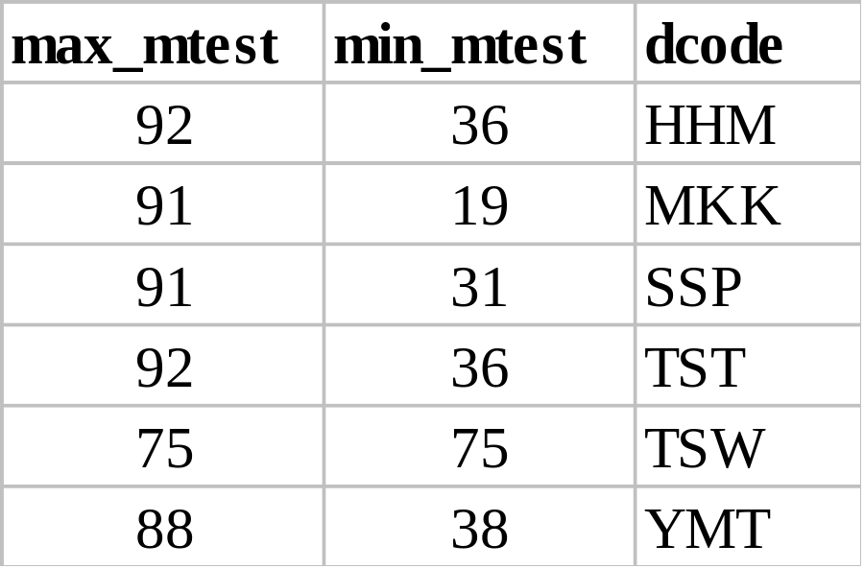
Grouping(Example)
  eg. List the max. and min. test score of Form 1 students of each district.
  SELECT MAX(mtest), MIN(mtest), dcode ;
  FROM student ;
WHERE class LIKE "1_" GROUP BY dcode
Result

Slide 43
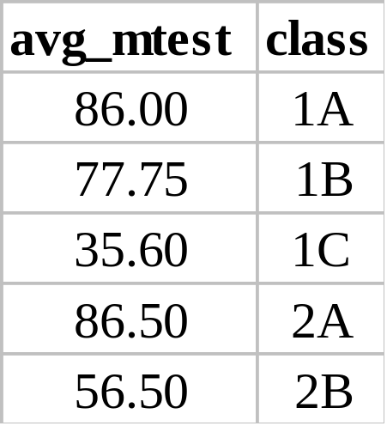
Grouping(Example)
  eg. List the average Math test score of the boys in each class. The list should not contain class with less than 3 boys.
  SELECT AVG(mtest), class FROM student ;
WHERE sex="M" GROUP BY class ;
HAVING COUNT(*) >= 3
Result

Slide 44
Multiple Table Queries
A query can return records as the result of a query across more than one relation.
These multiple relation queries are described as joins or Cartesian products.
SQL joins are used to query data from two or more tables, based on a relationship between certain columns in these tables.
A join often realizes relationships by equating a foreign key in one relation with the primary key of another.

Slide 45
Multiple Table Queries
The general form of the multiple table SQL statement can be described as follows:
  Name two or more relations in the FROM clause.
  Restrict the join in the WHERE clause.
  Create a relation with all attributes of the joined relation.
  If we remove the WHERE clause then the result is the Cartesian product
The join operation will combine the tables into one large table with all possible combinations (Math: Cartesian Product), and then it will filter the rows of this combined table to yield useful information.

Slide 46
Multiple Table Queries
field1
field2
A
1
field1
field2
A
2
A
1
A
3
2
B
B
1
3
B
2
B
3

Slide 47
The Situation:
Music Lesson
Each student should learn a musical instrument.
Two database files: student_DB & music_DB
The common field: student id
field type width contents
id numeric 4 student id number
type character 10 type of the music instrument

Slide 48

Natural Join
  eg. Make a list of students and the instruments they learn. (Natural Join)
id
name
class
id
type
9801
Same id
9801
Join
Student
Music
id
name
class
type
9801
Product

Slide 49
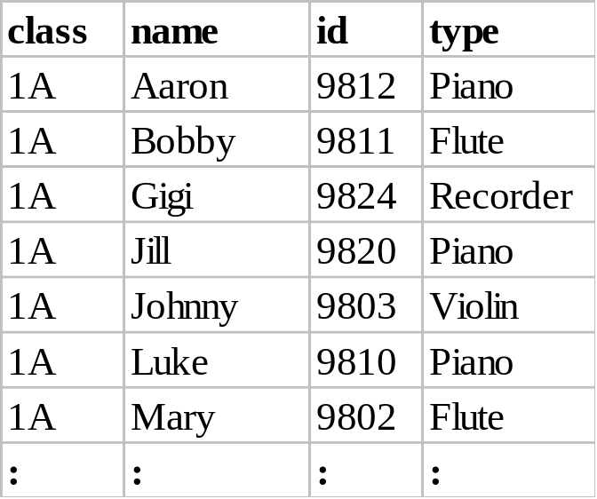
Natural Join
  eg. Make a list of students and the instruments they learn. (Natural Join)
  SELECT s.class, s.name, s.id, m.type ;
  FROM student s, music m ;
    WHERE s.id=m.id ORDER BY class, name
Result

Slide 50
Natural Join
  eg. Find the number of students learning piano in each class.
Three Parts :
(1) Natural Join.
(2) Condition: m.type="Piano"
(3) GROUP BY class

Slide 51
Natural Join
Student
Join
Condition
Group By
m.type= "Piano"
class
Product
Music

Slide 52
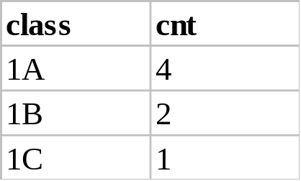
Natural Join
  eg. Find the number of students learning piano in each class.
  SELECT s.class, COUNT(*) ;
  FROM student s, music m ;
    WHERE s.id=m.id AND m.type="Piano" ;
    GROUP BY class ORDER BY class
Result

Slide 53
Introduction to PL/SQL and T - SQL

Slide 54

PL/SQL
PL/SQL stands for Procedural Language extension of SQL.
It was developed by Oracle Corporation in the early 90’s to enhance the capabilities of SQL.
The purpose of PL/SQL is to combine database language and procedural programming language.
The basic unit in PL/SQL is called a block, which is made up of three parts:
    The Declaration section (optional).
    The Execution section (mandatory).
    The Exception (or Error) Handling section (optional).

Slide 55
PL/SQL
Declaration Section:
  The Declaration section of a PL/SQL Block starts with the reserved keyword DECLARE. This section is optional and is used to declare any placeholders like variables, constants, records and cursors, which are used to manipulate data in the execution section.
Execution Section:
  The Execution section of a PL/SQL Block starts with the reserved keyword BEGIN and ends with END. This is a mandatory section and is the section where the program logic is written to perform any task. The programmatic constructs like loops, conditional statement and SQL statements form the part of execution section.
Exception Section:
  The Exception section of a PL/SQL Block starts with the reserved keyword EXCEPTION. This section is optional.

Slide 56
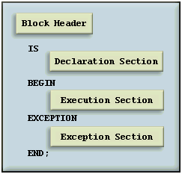
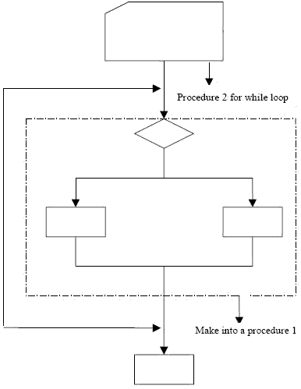
PL/SQL
This is how a sample PL/SQL Block looks.

Slide 57
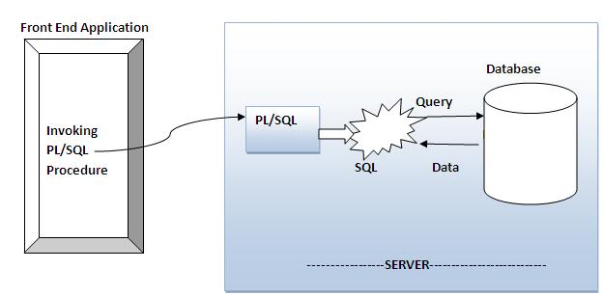
How PL/SQL Runs

Slide 58
Advantages of PL/SQL
Block Structures:
  PL SQL consists of blocks of code, which can be nested within each other. Each block forms a unit of a task or a logical module. PL/SQL Blocks can be stored in the database and reused.
Procedural Language Capability:
  PL SQL consists of procedural language constructs such as conditional statements (if else statements) and loops like (FOR loops).
Better Performance:
  PL SQL engine processes multiple SQL statements simultaneously as a single block, thereby reducing network traffic.
Error Handling:
  PL/SQL handles errors or exceptions effectively during the execution of a PL/SQL program. Once an exception is caught, specific actions can be taken depending upon the type of the exception or it can be displayed to the user with a message.

Slide 59

Transact-SQL(T-SQL)
Transact-SQL, an extension to the SQL database programming language.
It is a powerful language offering many features
    a wide variety of data types
    temporary objects
    system and extended stored procedures
    scrollable cursors
    conditional processing
    transaction control
    exception and error handling, and much more.
T-SQL (Transact-SQL) is a set of programming extensions from Sybase and Microsoft that add several features to the Structured Query Language (SQL).

Slide 60
Transact-SQL(T-SQL)
Transact-SQL is very closely integrated with SQL while adding programming capabilities not already standardized within the SQL database programming language.
At the same time Transact-SQL extends SQL, it also integrates seamlessly with it.
All applications that communicate with an instance of SQL Server do so by sending Transact-SQL statements to the server, regardless of the user interface of the application.

Slide 61
Summary
What you have learned?
  How to insert new records
  How to delete records and
  How to update records in a database with SQL.
  How to retrieve data using various conditions.
  Introduction to PL/ SQL
  Introduction to T- SQL
SQL is the standard language that works with all the well-known database systems like MS SQL Server, IBM DB2, Oracle, MySQL, and MS Access.

Slide 62

QUESTIONS

Slide 63


